Slide 1
Module 1: Just for fun
Introduction to Linux and Unix
1: Just for fun
2: Linus session
3: Using files and directories

Slide 2
Contents
Computer
Operating system
Origins of Unix and Linux
Linux Kernel portability
Linux and Unix diversity
Notes:
Although Linux and Unix can run on various computers, including mainframes, a PC is by far the most used type. Whether a desktop, a server, or a laptop, the term “PC” encompasses them all.
PCs use a massive variety of hardware, and several operating systems can control it.
In this chapter, we will briefly examine the various combinations on the theme, then concentrate on introducing Linux as a viable alternative to other operating systems in server, desktop, and cloud environments.

Slide 3
Computers
The “Kit”

Slide 4
What is a computer?
“An electronic machine that is used for storing, organizing, and finding words, numbers, and pictures, for doing calculations, and for controlling other machines”
Capable of being programmed to carry out a series of instructions
Hardware – no number crunching without it!
Hundreds of computer manufacturers
Various CPUs (processors)
Massive selection of other hardware and peripherals
Notes:
PC, Personal Computer, is nothing more than a bit of hardware, being controlled by a bit of software (known as an operating system), running even more software that we call applications.
Although the hardware can come from many manufacturers, and it vary in design and detail, PCs are commonly known as Intel-architecture or x86 machines (even though Intel is not the only CPU provider).

Slide 5
Basic types
Laptops / tablets:
Designed for portability
Runs on AC or battery
Desktops:
Ironically, typically below the desk
Not portable
Servers:
Stored in a cooled room
Or in the Cloud
Notes:
Laptops are portable, all-in-one computers suitable for personal use. They offer convenience and mobility but have limited hardware resources and upgrade options compared to desktops. They are ideal for personal tasks like browsing, office work, and media consumption.
Desktops are stationary, customizable computers with higher performance and upgrade potential. They are ideal for demanding tasks but lack portability. They are often used for gaming, video editing, and software development. Unlike laptops, they rely on external peripherals such as monitors, keyboards, and mice.
Servers are powerful, reliable machines designed to handle data or applications for multiple users. They prioritize scalability and continuous operation, often running specialized software in data centers. They often handle tasks such as hosting websites, managing databases, or running virtual machines.
Cloud instances are virtual computers accessed over the internet. They provide scalable, on-demand resources without requiring physical hardware, making them ideal for flexible workloads. The main cloud service providers include AWS, Azure, and Google Cloud Compute. They are ideal for workloads like hosting applications, data processing, and running containerised environments and eliminate the need for physical hardware, allowing for cost efficiency and flexibility.

Slide 6
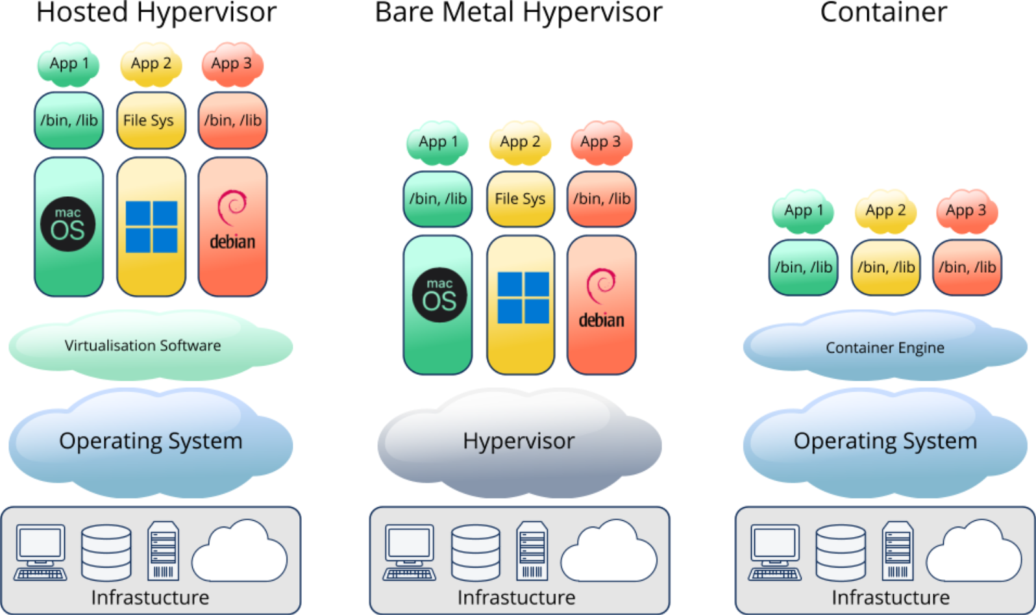
Virtualization
Notes:
Virtualization is the process of creating virtual versions of computing resources, such as operating systems, servers, or storage, using software. It allows a single physical machine to run multiple virtual machines (VMs), each acting as an independent system with its own OS, applications, and resources.
Key benefits of virtualization include efficient hardware utilization, cost savings, easier management, and the ability to run different operating systems simultaneously. It also supports isolation, meaning issues in one VM do not affect others.
Common virtualization tools in Linux include KVM (Kernel-based Virtual Machine), VirtualBox, and VMware. Virtualization is widely used in testing, development, and server consolidation.
Hosted is also called Type 2. Bare Metal is called Type 1.

Slide 7
Operating system
Using the computer

Slide 8
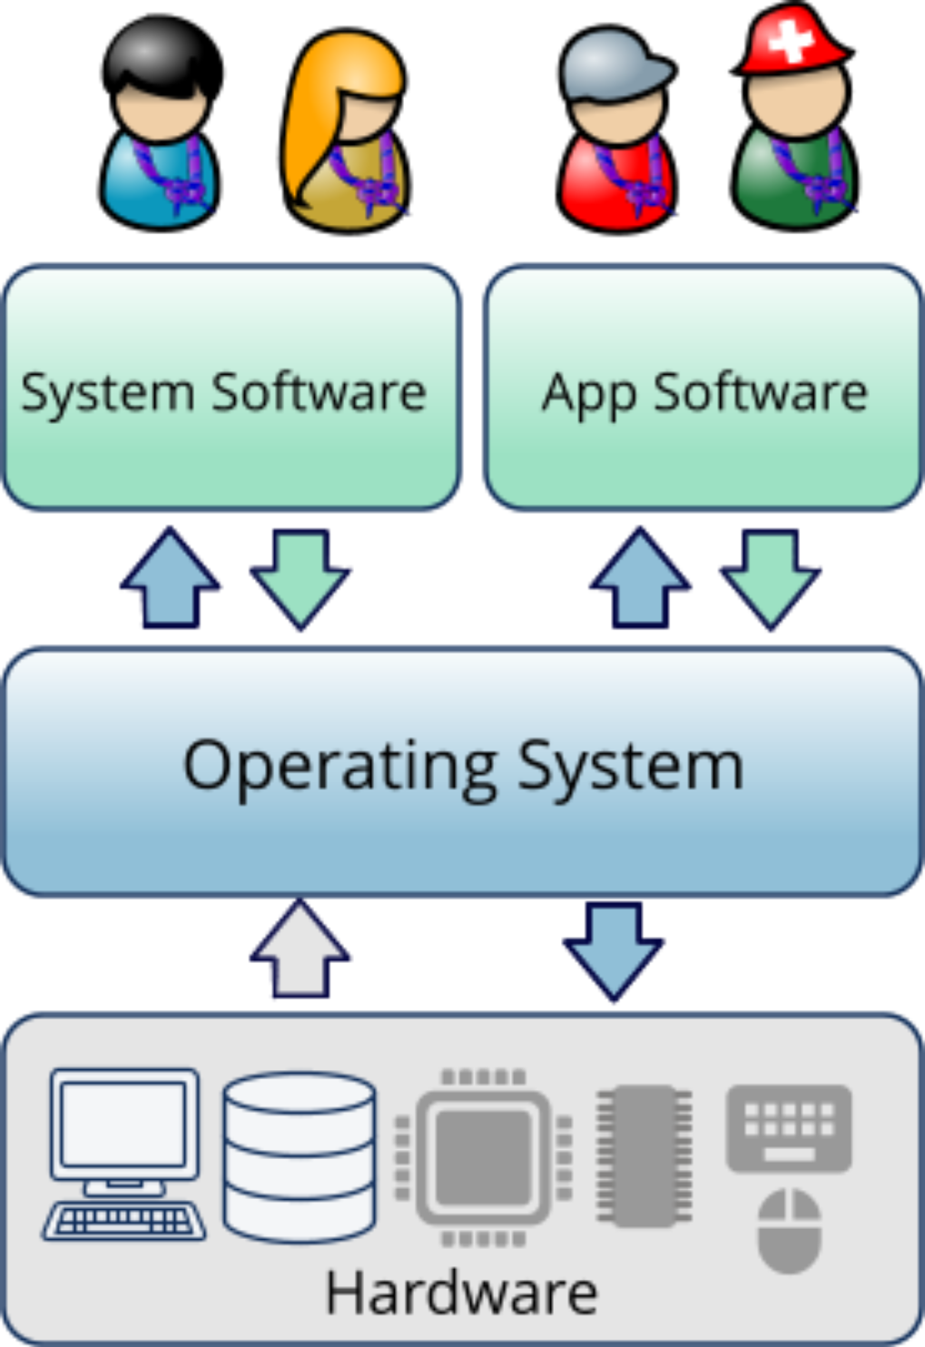
What is an operating system (OS)?
A (time-sharing) operating system is system software that manages:
Computer hardware.
Software resources.
Provision of common services for computer programs.
Scheduling tasks.
Notes:
An operating system (OS) is the core software that manages a computer's hardware and software resources. It acts as a bridge between the user, applications, and hardware, enabling them to work together efficiently.
Key functions of an OS include:
Resource management: Allocates CPU, memory, and storage to processes.
Process management: Handles running applications and multitasking.
File system management: Organizes and manages data storage and retrieval.
Device control: Interfaces with hardware like printers, keyboards, and displays.
User Interface: Provides a graphical or command-line interface for interaction.
Linux is a popular open-source operating system known for its flexibility, security, and use in servers, desktops, and embedded systems.

Slide 9
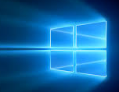



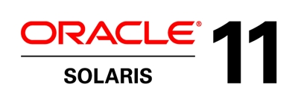

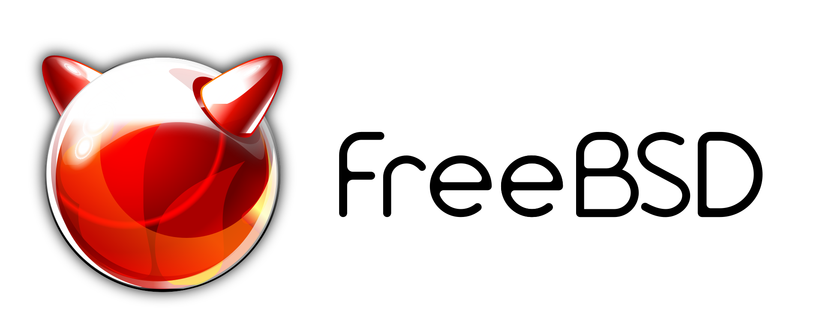
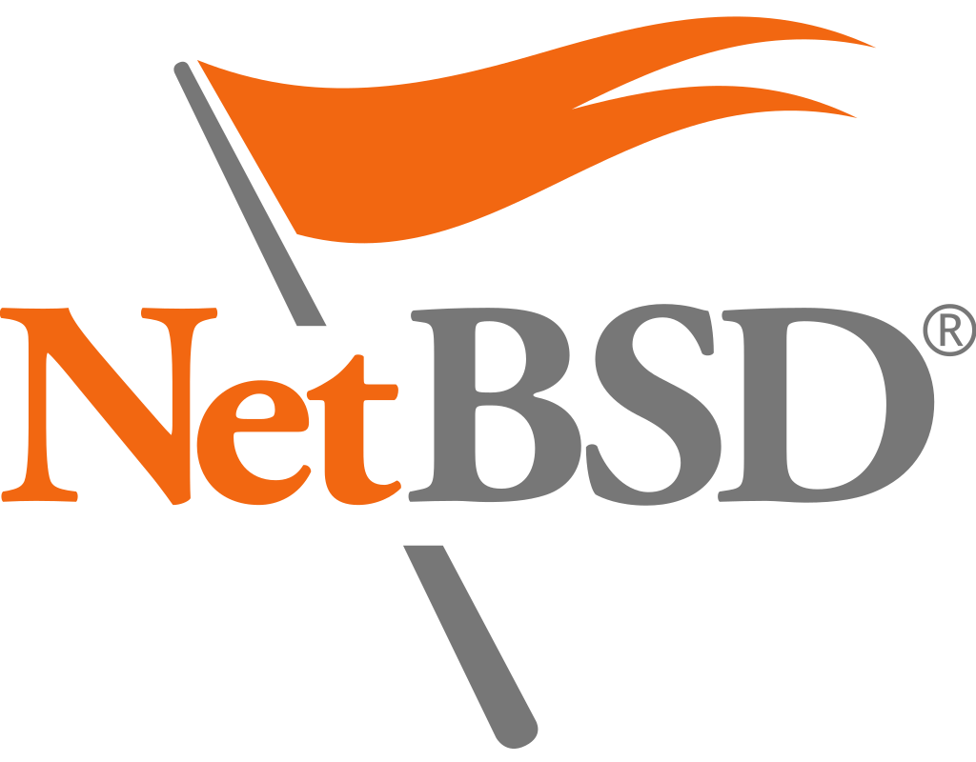
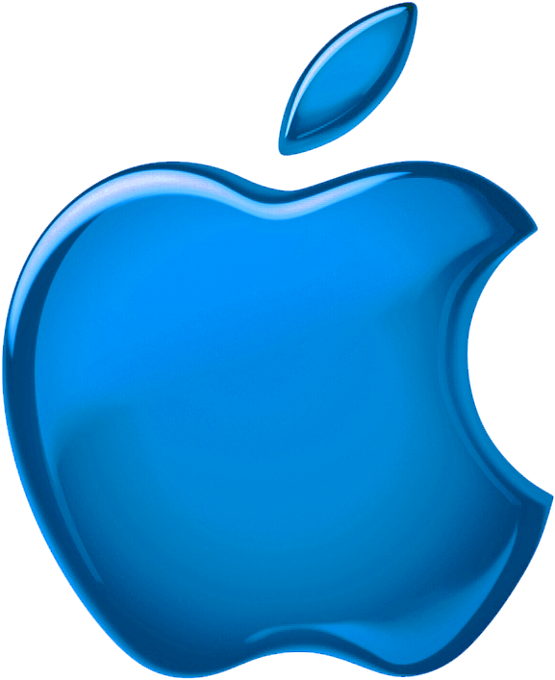
The PC family of operating systems
Microsoft Windows
Windows 10, 11
Windows Server(s)
Linux
Several fully supported distributions:
Red Hat, SUSE, Ubuntu
Numerous other distributions
UNIX
Solaris 11
NetBSD, FreeBSD, OpenBSD
MacOS X, IOS
Notes:
Windows, developed by Microsoft, is a popular OS known for its user-friendly interface and compatibility with a wide range of hardware. It dominates the consumer and enterprise markets. Major versions include Windows 10, Windows 11 and supports both graphical and command-line interfaces, with a focus on ease of use.
Linux is an open-source operating system based on the Linux kernel. It is highly customizable, secure, and widely used in servers, desktops, and embedded systems. Popular distributions include RHEL, Ubuntu, Fedora, Debian, SUSE, and Arch Linux. Linux is favoured for its stability, flexibility, and active community support.
Unix is a family of multitasking, multiuser operating systems originally developed in the 1970s. Known for its robustness, it serves as the foundation for many modern OSs, including Linux and macOS X. Major Unix versions include AIX, Solaris, and HP-UX. Unix is primarily used in enterprise environments for its reliability and scalability but also includes several open-source flavors such as FreeBSD, OpenBSD, and NetBSD.

Slide 10
Origins
History

Slide 11
Unix and Linux origins
Before Unix: 1969: Multics – Bell Labs
Ken Thompson: 1970: Unics -> Unix https://en.wikipedia.org/wiki/History_of_Unix
Denis Ritchie – C programming language : Portability
Bill Joy – Free Unix : 1978: BSD
Linus Torvalds: 1991: Linux https://en.wikipedia.org/wiki/History_of_Linux
Notes:
Unix was created in 1969 at AT&T's Bell Labs by Ken Thompson and Dennis Ritchie and loosely based on an earlier OS called Multics. It was designed as a simple, portable, and multitasking operating system, initially written in assembly language and later rewritten in C by Ritchie, which made it highly portable. Unix became the foundation for many modern operating systems due to its modular design and powerful tools.
Linux was developed in 1991 by Linus Torvalds as a free, open-source operating system inspired by Unix. While Unix was largely proprietary, Linux adopted the Unix principles and combined them with contributions from the open-source community. Meanwhile, in the 1980s, Bill Joy, co-founder of Sun Microsystems, contributed to Unix by creating BSD (Berkeley Software Distribution), which significantly influenced both Unix and Linux development. Together, these innovations shaped the OS landscape.
Both have a long history and are explained in detail on Wikipedia:
https://en.wikipedia.org/wiki/History_of_Unix
https://en.wikipedia.org/wiki/History_of_Linux

Slide 12
Unix schism
System V (1983)
Unix
PDP/7 (1969)‏
BSD v1.x (1975)
SVR3 (1987)
AT&T Unix 1st edition
PDP/11 (1970)
4.2BSD (1975)
SVR4 (1989)
Unifying SV, BSD
and Xenix
Unix 4th edition
C (1973)
4.4BSD (1993)
System V ‘Family’
Unix 6th edition
Outside Bell Labs (1975)
BSD ‘Family’
Xenix (1975)
Microsoft
Notes:
Centre branch:
Unix PDP-7 (1969): Unix was created by Ken Thompson and Dennis Ritchie at Bell Labs for the PDP-7. It was a simple and efficient multitasking OS with file system and process management, designed to meet the lab’s needs.
Unix 6th Edition (1975): Also known as Version 6 Unix, this was a landmark release widely distributed to universities and research institutions. Its portability and availability helped expand Unix’s influence.
Left branch: System V
System V (1983): Developed by AT&T, System V standardized Unix features, including the System V Interface Definition (SVID), the System V Init daemon, job control, and inter-process communication.
SVR4 (1988): System V Release 4 merged features from BSD, Xenix, and earlier System V versions, becoming a widely adopted Unix standard for enterprise environments.
Right branch: BSD (Berkeley Software Distribution)
BSD 1.0 (1977): Bill Joy and his team at UC Berkeley began modifying Unix, adding features like the vi editor, virtual memory and the TCP/IP networking stack.
BSD Evolution (1977-1993): Over the years, versions like 4.3BSD and 4.4BSD brought further advancements, particularly in networking, forming the basis for modern systems like FreeBSD, OpenBSD, and macOS.
This timeline highlights Unix’s evolution into a family of operating systems, with BSD driving innovation in open-source and networking, while System V shaped enterprise solutions with both influencing modern operating systems including Linux.

Slide 13

From Unix to Linux
Unix
System V‏
Interest in writing OS
MINIX‏
A UNIX-Like OS
Introduced as an OS teaching Aid
By Andrew S. Tanebaum
Inspires Linus Torvalds
Linux‏
While writing
‘Just For Fun’
Torvalds created
an OS Kernel
for his 80386PC
BSD
Applications from
Notes:
After Unix became increasingly commercialized, Andrew S. Tanenbaum developed Minix as a Unix-like operating system for educational purposes. Minix was lightweight and open for study but lacked the power needed for broader use. It served as an inspiration for Linus Torvalds when he began developing Linux.
Linus Torvalds created Linux as a free and open-source kernel influenced by Unix principles and Minix. Unlike Minix, Linux was intended for practical, scalable use and rapidly grew with contributions from the open-source community.
While BSD focused on developing advanced features like networking (TCP/IP) and virtual memory, its open-source tools and utilities were eventually integrated into Linux distributions. This connection brought a rich suite of Unix-like applications to Linux, enabling it to become a complete operating system.
Linux’s development bridged Unix principles, Minix inspiration, and BSD’s software innovations to create the powerful, flexible, and widely adopted open-source operating system we know today.

Slide 14
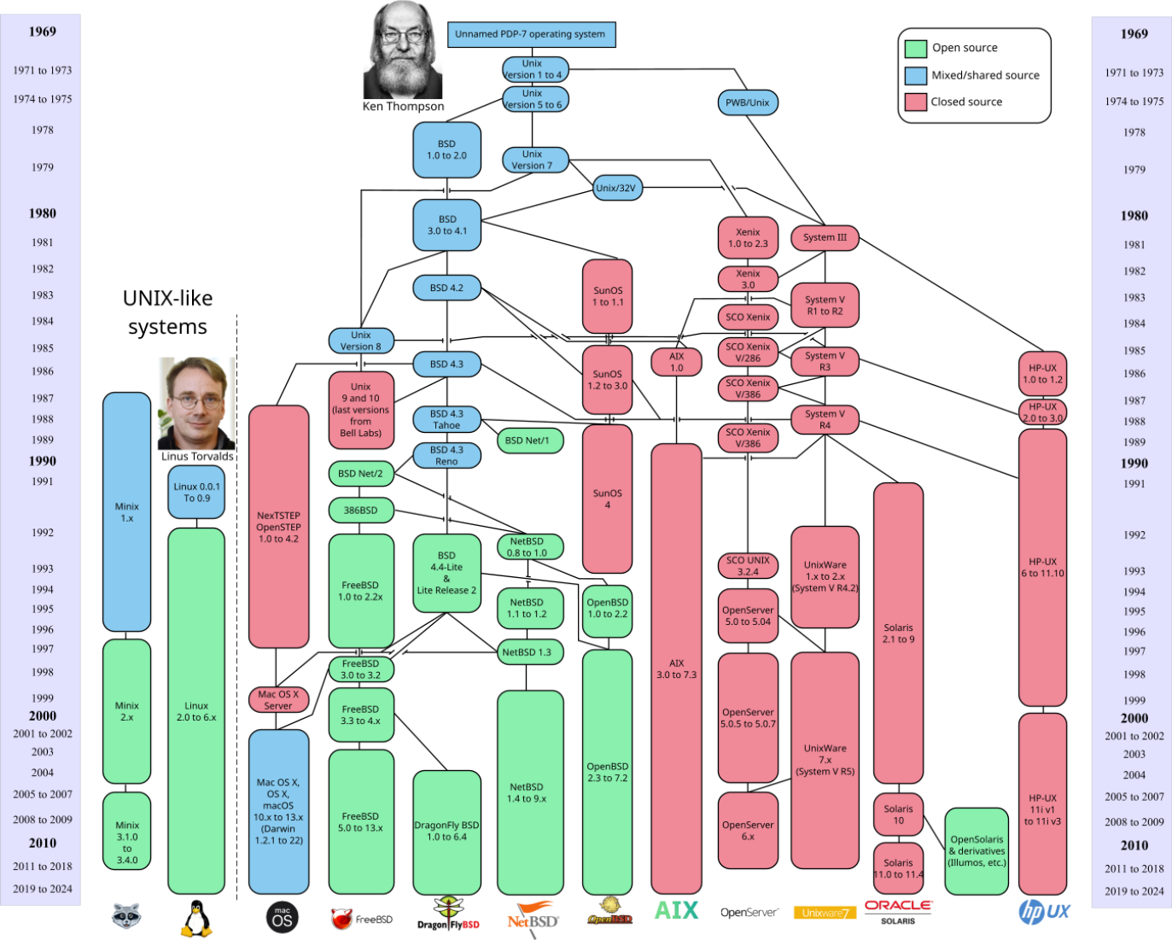
Unix / Linux timeline
Notes:
This should give you an idea of what happened when.

Slide 15
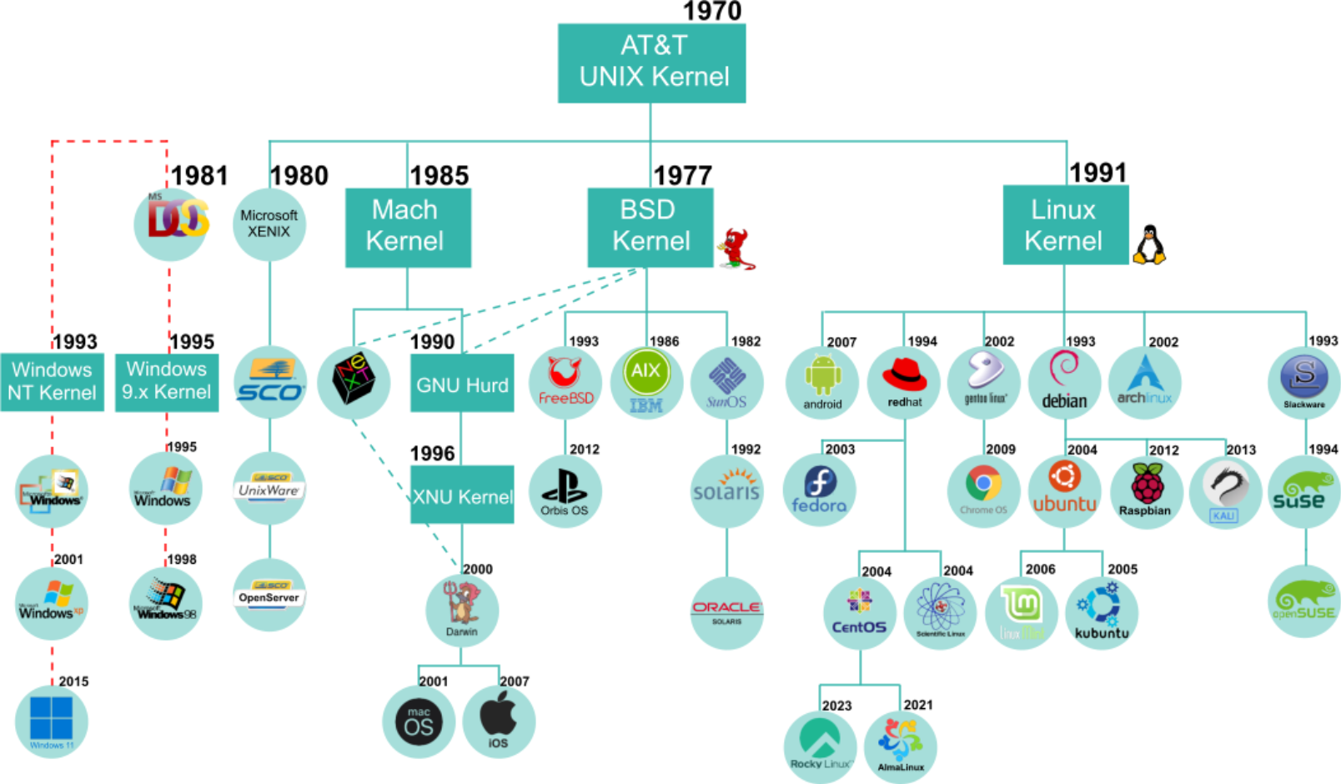
OS family tree
Notes:
The sheer number of Unix flavors and GNU/Linux distributions can make understanding their relationships challenging. This slide simplifies the family tree, illustrating how various Unix and Linux systems branched from their respective kernels and operating systems.
It's important to note that both Unix and Linux are not limited to corporate servers from companies like IBM, HP, and Oracle/Sun. They are also widespread in desktop and mobile environments. For example, macOS X is a Unix-based BSD variant, while Android is a Linux-based operating system with a polished, user-friendly interface.
Interestingly, even Microsoft’s MS-DOS and early Windows systems took inspiration from Unix through Xenix, a Microsoft port of AT&T Unix to PC architecture. Features like the file system structure, the PATH variable, and commands like cd, mkdir, and rmdir trace their roots to Unix.
If you wish to explore GNU/Linux distributions, a great resource is DistroWatch (https://distrowatch.com/), where you can discover popular and niche distributions to suit your needs.

Slide 16
Linux kernel portability

Slide 17
What is a kernel?
A layer of software that sits between the software and the hardware
The core of the operating system
Notes:
A kernel is the core component of an operating system that acts as a bridge between hardware and software. It manages system resources like the CPU, memory, and devices, ensuring applications can function seamlessly without directly interacting with hardware.
In the Linux ecosystem, the kernel sits between the hardware and the operating system components (such as GNU tools) and interfaces like the GUI (Graphical User Interface) or CLI (Command Line Interface). Applications run on top of these layers. The modular design of Linux allows users to swap or customize the GUI, use various command-line tools, and interact directly with the kernel for high control and flexibility.
The Microsoft Windows kernel, while also managing hardware and system resources, is tightly integrated with the Windows operating system. Unlike Linux, Windows has a more monolithic structure, where most components are interdependent. Applications communicate with the kernel through APIs, and the user is generally limited to predefined GUIs and tools.

Slide 18

Linux kernel portability
Fully fledged, (32- and) 64-bit operating system
Written in C, C#
POSIX compliant
Portability at source level between Linux, Unix, and even Windows is possible
Developed under GNU License
Source code is freely available
Can be compiled to run on a variety of platforms:
Intel from 386 to modern multi-core i3, i5 and i7
ARM chips including the Raspberry PI
Supports instruction, task, and data-level parallelization
Notes:
The Linux kernel is renowned for its portability, which can run on various hardware architectures. This flexibility stems from its modular design and the open-source contributions of developers worldwide.
Initially created for Intel's x86 architecture, the Linux kernel has been successfully ported to numerous platforms, including ARM (common in smartphones and IoT devices), PowerPC, MIPS, RISC-V, and even mainframes. This adaptability enables Linux to power everything from tiny embedded systems and mobile devices to enterprise-grade servers and supercomputers.
Its architecture-agnostic design allows developers to easily modify and optimize the kernel for new or specialized hardware without needing to rebuild the system. This capability has driven Linux's widespread adoption across industries and cemented its role as the backbone for systems like Android, automotive software, and cloud computing infrastructure.
It is a collection of software consisting of the Kernel from Linus Torvalds and open-source collaborators, and tools from the GNU project from Richard Stallman and the Free Software Foundation, under the GPL license. Linux is POSIX (Portable Operating System Interface) compliant, an IEEE set of standards based on Unix, that determines compatibility across multiple operating systems.

Slide 19
Linux and Unix diversity
Distros and flavors

Slide 20
Unix diversity
Unix is an old, but a commonly-used OS.
Unix types are called flavors.
There are several UNIX kernels:
Typically, different kernels in different flavors
The licensing can also vary
Mostly based on BSD
The BSD license allows closed source, so is used by vendors such as Apple.
Notes:
In the early days, Unix was highly fragmented, as different computer vendors created their own versions of the operating system. This led to a wide variety of Unix releases, each tailored to specific hardware platforms.
The diversity of Unix systems caused significant compatibility challenges, not only in system management but also at the kernel level. Hardware-specific differences made it difficult to port software and skills across Unix variants, creating barriers for developers and users.

Slide 21



BSD
FreeBSD: Ease of use
NetBSD :Most portable
OpenBSD: Security
Darwin: MacOS and IOS
https://en.wikipedia.org/wiki/Comparison_of_BSD_operating_systems.
Notes:
There are many flavors of the BSD operating System:
FreeBSD: A performance-focused BSD variant widely used for servers, networking, and storage. It offers advanced features like the ZFS filesystem and is known for its stability and scalability.
NetBSD: Designed for maximum portability, NetBSD runs on a vast range of hardware, from embedded systems to supercomputers. Its lightweight and clean codebase makes it ideal for research and experimentation.
OpenBSD: Prioritizing security and code correctness, OpenBSD is used in firewalls, VPNs, and other security-focused applications. It includes strong cryptography and proactive security features.
Darwin: The Unix-based core of Apple's macOS and iOS, Darwin incorporates elements from BSD and Mach. While it is open-source, much of Apple’s user interface and ecosystem remain proprietary.
A good comparison of these and other variants can be seen at the following Wikipedia link:
https://en.wikipedia.org/wiki/Comparison_of_BSD_operating_systems.

Slide 22




System V
OpenSolaris HP-UX
Illuminos UNIX IBM AIX
https://en.wikipedia.org/wiki/UNIX_System_V
Notes:
And there are also many flavors of System V Unix operating systems. A few still in use today include:
OpenSolaris: Originally developed by Sun Microsystems, OpenSolaris was an open-source version of Solaris, featuring advanced features like ZFS, DTrace, and Zones. It later evolved into Illumos, a community-driven fork that continues Solaris development.
Illumos: A fork of OpenSolaris, Illumos serves as the foundation for modern Solaris-based systems such as SmartOS and OmniOS, focusing on enterprise reliability, security, and cloud integration.
HP-UX: Hewlett-Packard’s Unix variant designed for high-performance enterprise environments. Known for strong reliability, scalability, and features like Serviceguard for high availability.
IBM AIX: IBM’s Unix system optimized for POWER PC architecture. It includes advanced performance tuning, security features, and virtualization technologies like PowerVM, making it a preferred choice for enterprise workloads.
Again, further reading can be found on Wikipedia: https://en.wikipedia.org/wiki/UNIX_System_V.

Slide 23
Licensing
Software provided with Linux does not have to be free:
Linux is free.
Applications may not be.
Linux applications do not have to be:
Licensed under GPL.
Licensed under any other open-source scheme.
Several applications ported to Linux are commercial:
Like VMWare or Oracle.
These are not provided with source code; may not be modified.
They may not be freely re-distributed or re-sealed.
Moral of the story: read the licensing agreement!
Notes:
The core principle of GNU is that software should be accessible to everyone. Users should have the freedom to modify programs to suit their needs, and any modifications should be freely available to others.
The GNU General Public License (GPL) allows software creators to retain legal copyright while choosing whether to charge a fee or distribute their work for free. However, even if a fee is charged, the license requires that the source code be included, enabling others to study, modify, and improve the software.
This requirement is a major concern for many commercial vendors, as they often hesitate to use GNU-licensed software within their products to avoid exposing their proprietary source code to competitors.
It's important to note that while Linux distributions often bundle commercial applications, their inclusion does not necessarily grant full modification rights. These applications may be free to use but still subject to licensing restrictions.
Linux is a free operating system, but understanding software licenses remains essential to ensure compliance and avoid unintended legal issues. Moral of the story is to read the license!

Slide 24

Linux diversity
Linux is available as part of many distributions.
The kernel is packaged with many applications.
There is only one Linux kernel, owed by Linus Torvalds:
Same kernel (Linux) in all distributions
Licensed under GNU GPL – general public license
GPL in a nutshell
The original author retains the copyright to their software
Others can do what they wish with the GPL software
Notes:
The key point to understand about Linux is that there is only one Linux kernel. While there are many different distributions – each varying in applications, packaging, tools, and drivers – they all run on the same base kernel. Anyone can access the official Linux kernel source code at www.kernel.org, download it, and use or modify it as needed.
Linus Torvalds retains the copyright and trademark for the Linux kernel, while many of its utilities are licensed under the GNU General Public License (GPL). The GPL ensures that software remains free to use, modify, and share. The term GNU (GNU’s Not UNIX) is a recursive acronym, reflecting its goal of creating a free Unix-like system.
The GNU Project was launched in 1983 by Richard Stallman to develop a fully free operating system. In 1985, he also founded the Free Software Foundation (FSF), a nonprofit organization committed to eliminating restrictions on copying, modifying, and redistributing software. The FSF promotes the use and development of free software across all areas of computing.

Slide 25
Open-source economics
Free? How come?
Authors of Linux did not intend to make money from it.
Linux is meant to be freely available to everyone.
Pride of the designers – the best problem-solving mechanism.
Distributors do make money out of Linux
Though not from the operating software itself.
Major distributors now offer, at a price:
Complete product (and add-on applications).
Installation, user, and operation books and manuals.
Maintenance and support contracts.
Consultancy and training.
Software development.
Notes:
Every Linux distribution includes access to the source code, as required by the GNU General Public License (GPL). However, distributors often assume most users don’t need it, so you may have to request it explicitly. What you do with this code is entirely up to you.
To understand the impact of open-source development, “The Cathedral and the Bazaar” is an insightful read on the power of collaborative software creation. A great starting point for exploring open-source principles is www.opensource.org.
Even major corporations have adapted to the open-source movement. As Tim O’Reilly noted, Microsoft has had to evolve: "Open Source will change the way Microsoft does business—it already has. But Microsoft is not going away.
Open Source will create new players, but Microsoft is big enough to be around for a long time to come."
Linux distributors do generate revenue, primarily through enterprise services. Leading vendors now offer complete solutions, including 24/7/365 support and maintenance contracts, which have become their primary source of income. These contracts can be costly, but for businesses relying on Linux, they provide essential stability and reliability.

Slide 26

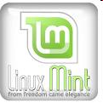











Major distros
Red Hat: RHEL / Fedora
Fedora – community version:
Centos now based on this
AlmaLinux and Rocky based on RHEL
SuSE: SLES / SLED
Originated in Germany, very popular in Europe
Replaced Netware in Novell’s systems
Now independent again
Debian
Regarded as ‘geeks’ distributions
Ubuntu from Canonical
Derivative of Debian
Notes:
With many Linux distributions available, they all share the same Linux kernel, and a similar set of tools, utilities, and desktop environments. The key differences lie in the installation process, included device drivers, directory structure, and distribution-specific management tools.
Red Hat has experienced rapid growth. CentOS (Community ENTerprise Operating System) was a free, downstream of Red Hat Enterprise Linux (RHEL), offering stability and long-term support without subscriptions. However, in 2020, it was replaced by CentOS Stream, which is now a mid-stream, rolling-release version of RHEL, acting as a preview its updates. While it provides a more dynamic development model, it lacks the long-term stability, leading many to migrate to alternatives like Rocky Linux and AlmaLinux.
SUSE initially thrived in Germany and expanded globally.
Ubuntu, developed by Canonical, founded by Mark Shuttleworth, has emerged as a major Linux player. Built on Debian, Ubuntu offers its own software repository, and a distinct release model. Positioning Ubuntu for desktop, server, and cloud environments, making it a key force in the Linux ecosystem.

Slide 27
Linux: Good and bad point
The good
Available on a wide range of hardware
Powerful and flexible command set
Very productive software-development environment
Easy connectivity with other systems
The bad
Raw system is not easy for novices to use, but Gui’s can circumvent this
Initially no support for real-time applications, but now many real-time processing kernels exist
Simplistic print spool and backup utilities, but most use third-party spoolers and manufacturer's backup regimes
Notes:
Linux has its strengths and weaknesses.
Good points:
Open source: Linux is open-source, which means its source code is freely available for anyone to modify and distribute.
Customization: Linux offers extensive customization options, allowing users to tailor the system to their specific needs and preferences.
Variety of distributions: There are numerous Linux distributions (distros) available, catering to different user requirements.
Powerful command set: Linux borrows thousands of command line tools from Unix, often adding extra features to them.
Software development: Most of the popular software programming languages (C/C++, Java, Python) originated or are available on Linux.
Bad points:
Hardware compatibility: Although Linux supports a wide range of hardware, there can still be instances where drivers for certain devices are not available or require manual installation.
Learning curve: Linux can have a steep learning curve, especially for users new to command-line interfaces and system administration.
Software availability: While Linux has a growing number of applications, some proprietary software and games may not be available or require additional steps to run through compatibility layers like wine.

Slide 28

Who uses Linux?
Notes:
Linux is used in a variety of industries and institutions. The open-source nature of much of the code is particularly of interest to governments and scientists alike.

Slide 29
Review and lab

Slide 30
Review questions
What is the fundamental purpose of the operating system?
What is a common element of all Linux distributions?
What is the difference between Linux licensing and that of UNIX?
Imagine a scenario whereby the display card failed on your computer, which is running Linux or UNIX; what consequence would this have to the effectiveness of the operating system?
Notes:
Operating system is the essential program, necessary to provide access to the underlying hardware, through a set of device drivers. The kernel (the operating system program) is also responsible for other tasks, such as process, memory and time management.
All distributions share the Linux kernel. Distributor may choose to use a different generation of the kernel, and they may choose to customise it to their liking, but “there is only one Linux”!
Linux is subject to open-source licensing, GNU GPL, and is available on a variety of hardware platforms (i.e. Linux is not tied to any manufacturer or hardware platform).
On Linux/UNIX GUI is an application. Consequently, a failed display card would stop users from having access to graphical applications, but the actual operating system will continue running.

Slide 31
Practical exercise 1
In the accompanying Exercise Guide (feel free to start two of the VMs)

Slide 32
Summary
What is a computer?
Hardware
What is an OS?
Programs that give access to hardware
Unix and Linux origins
Written by programmers for programmers
Portability
Run on many systems
Linux distributions
Where we actually get Linux from
BSD flavors
Ease of use vs. security vs. portability

